Slide 1
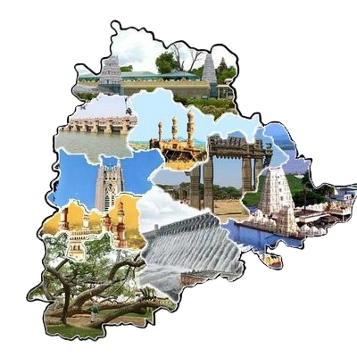
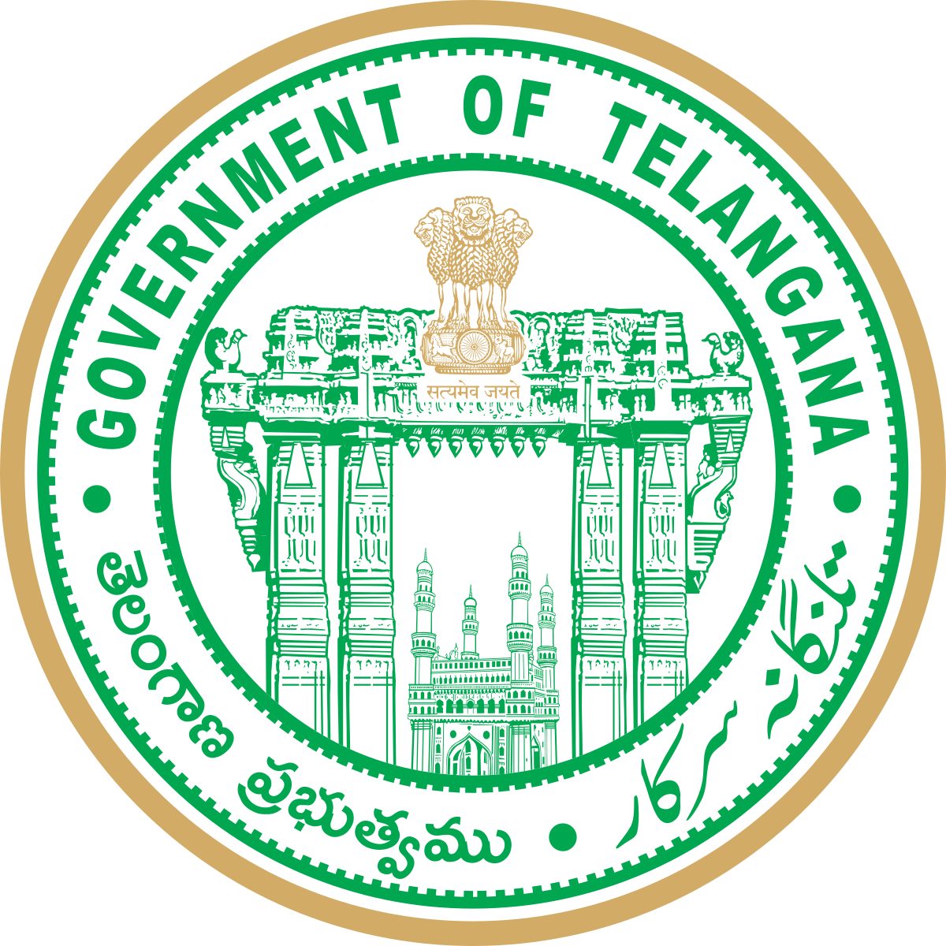
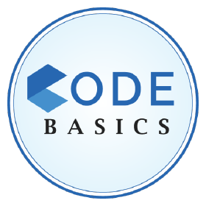

Telangana Tourism
Analysis Insights Recommendations

Slide 2
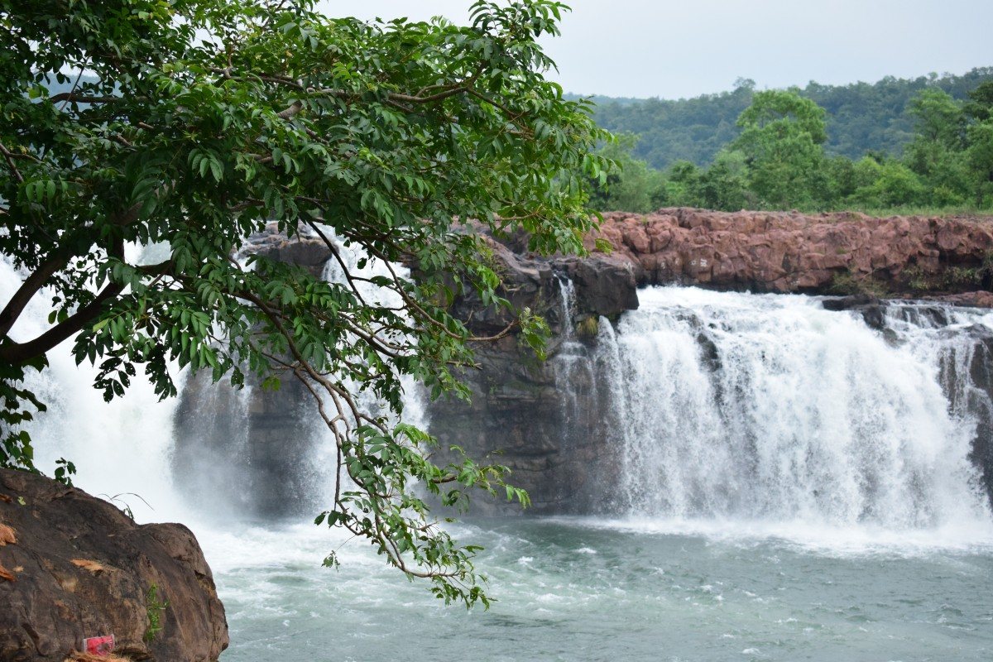
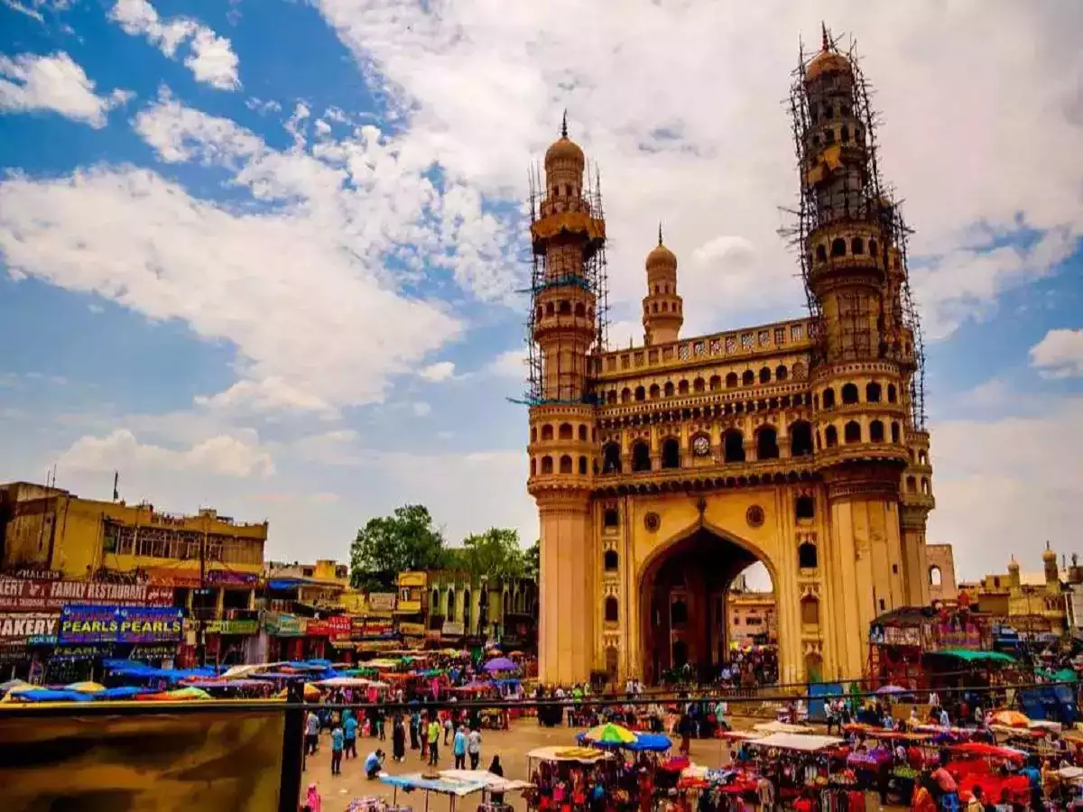
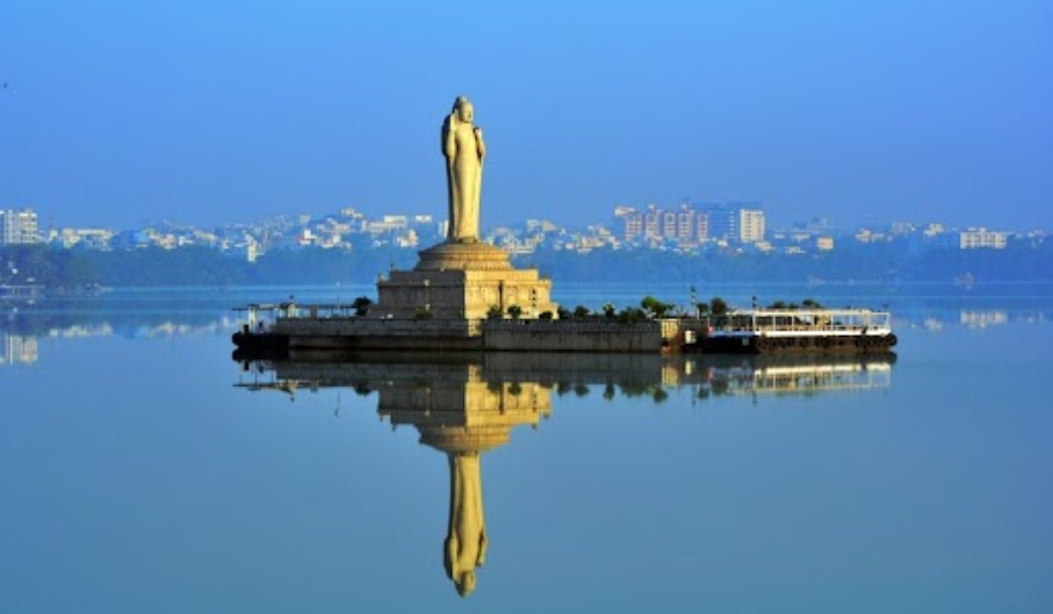

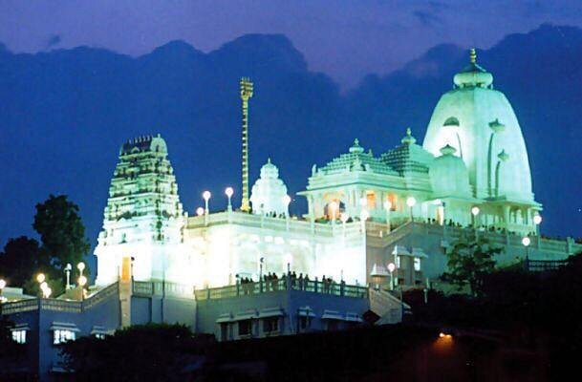
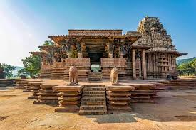
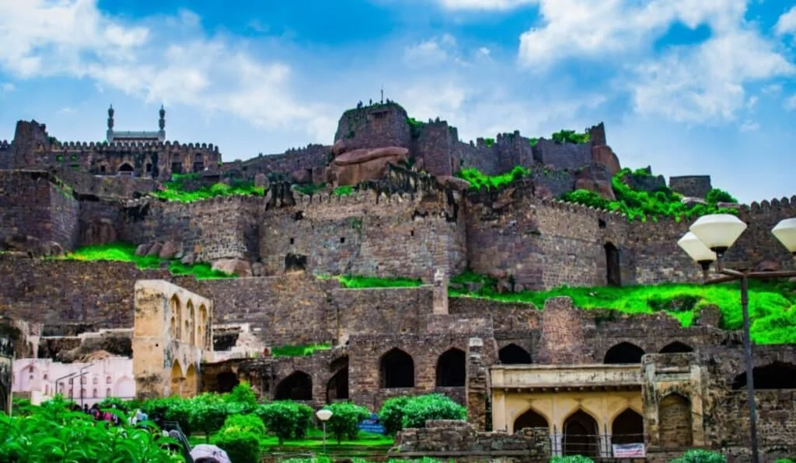
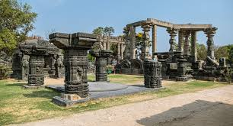
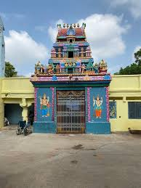
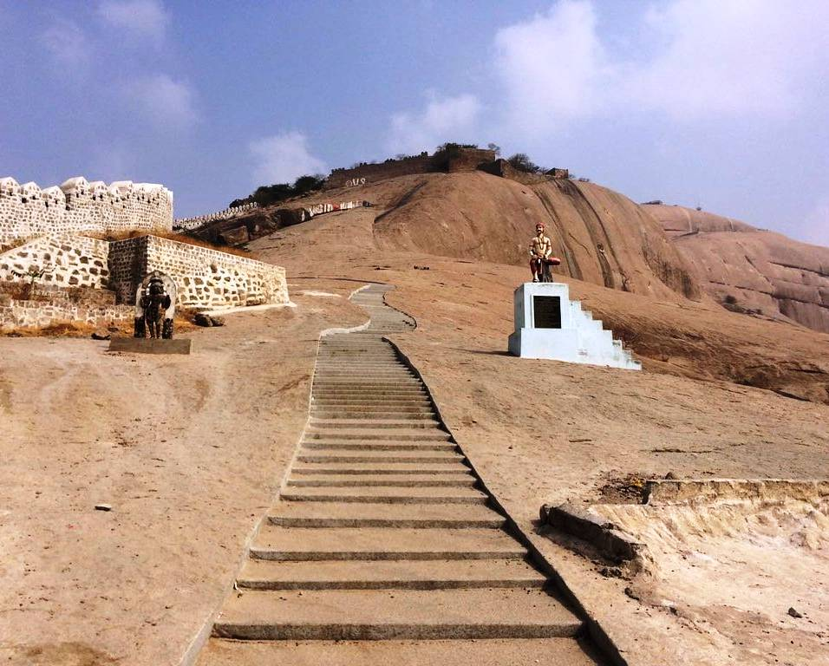
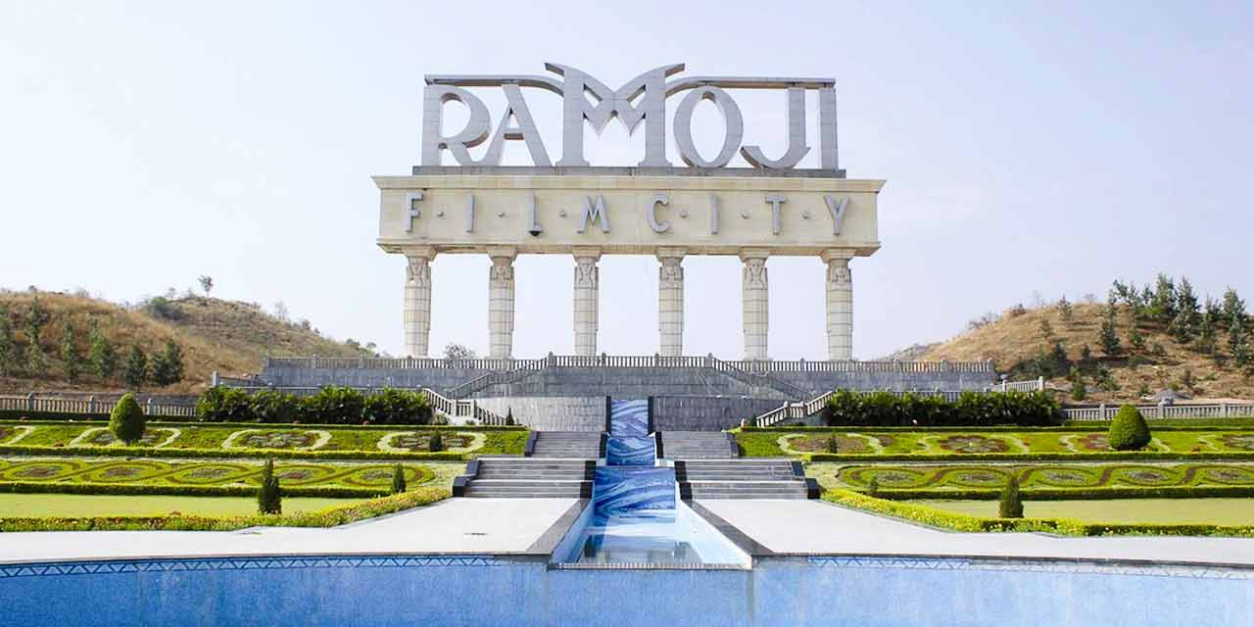
Telangana – Deccan’s Diamond
Telangana became the newest state in 2014, as the 29th state of India.
It is comprised of 33 districts, a perfect blend of
Rich history (Golconda Fort, Warangal Fort, Birla Mandir, etc)
Thriving present with economic boom ( 11.9% GSDP ↑ in 2023-24)
Promising future
Telangana is known as the land of waterfalls with Kuntala, Kanakai & Gayatri waterfalls being some of the most famous.
Telangana is home to Asia’s largest artificial lake Hussain Sagar & world’s largest Film studio Ramoji Film city.
This state exemplifies the harmonious coexistence of culture, nature and economic growth.

Slide 3
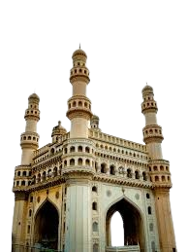
State Capital – Hyderabad
The “city of pearls” is a unique confluence of tradition and modernity.
It is home to iconic landmarks such as Charminar, Golconda Fort, Hussain Sagar Lake, Ramoji film city, etc.
In addition to being a vibrant cultural hub, Hyderabad is also emerging as a leading center for IT parks and economic growth.

Slide 4
Content
Objectives
Preliminary Questions
Secondary Questions
Post- Covid Analysis
Recommendations

Slide 5
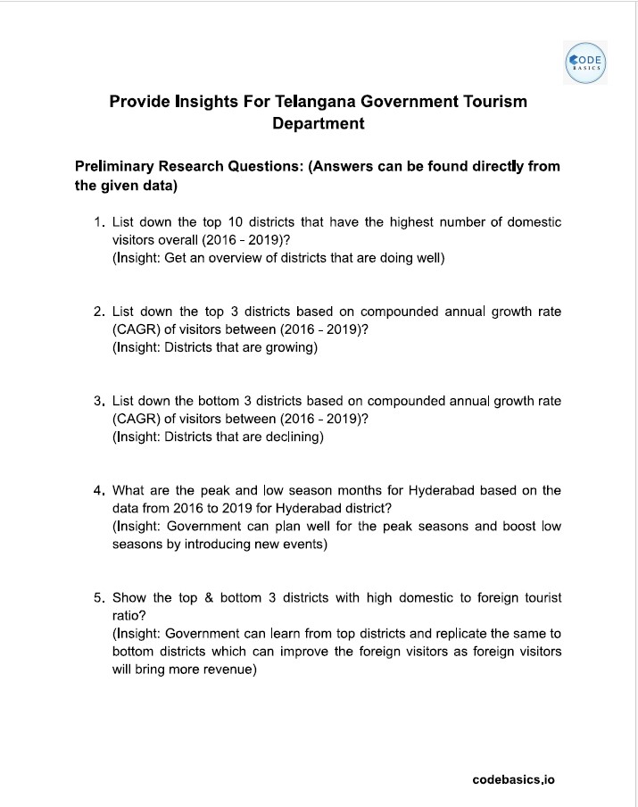
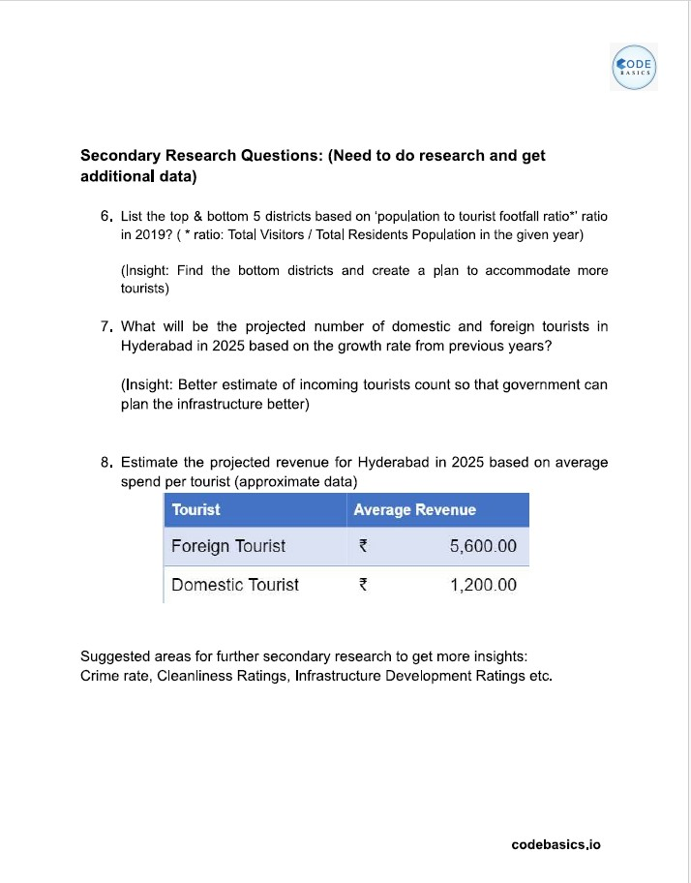
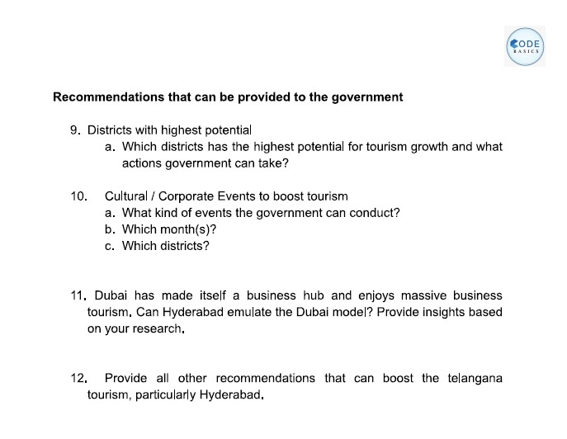
Preliminary Research Questions
Secondary Research Questions
Recommendations
Data source : https://data.telangana.gov.in/

Slide 6
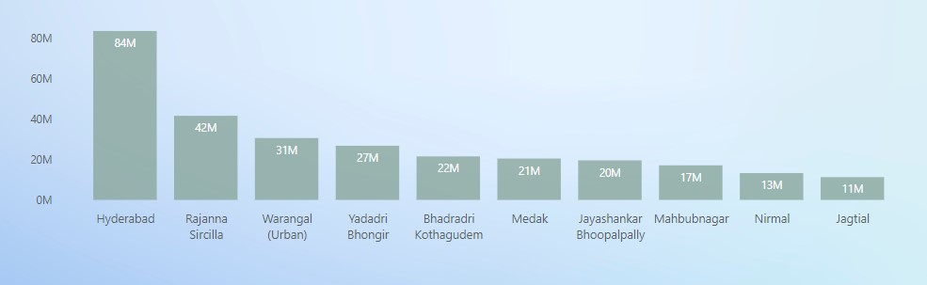
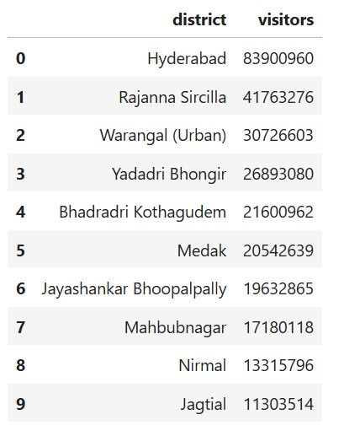
1. List down the top 10 districts that have the highest umber of domestic visitors overall (2016-2019)?
Hyderabad attracts the highest no. of domestic visitors with 84M, followed by Rajanna Sircilla with 42M and Warangal (urban) with 31M.
The steep difference bw Hyderabad and other districts can be owed to its growing IT park, amusement parks and modern infrastructure that additionally attracts the younger population.

Slide 7
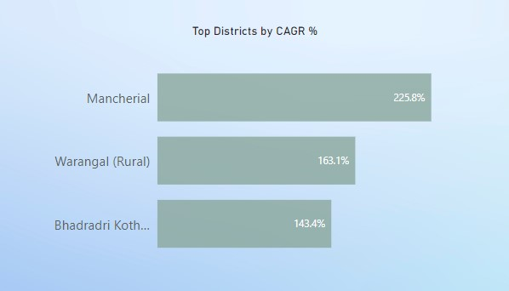
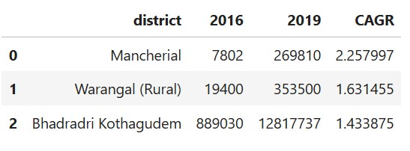
2. List down the top 3 districts based on CAGR of visitors between (2016-2019)?
Mancherial, Warangal (rural) and Bhadradri Kothagudem show consistent increase in the influx of tourist over the years from 2016-2019.
Mancherial is home to many wildlife sanctuaries that attract the nature enthusiasts.
Warangal is home to the second largest tribal festival in the world i.e Sammakka Sarakka Jatara.
Bhadradri Kothagudem has religious significance drawing tourist to Bhadrachalam Temple accompanied with rural tourism potential.

Slide 8
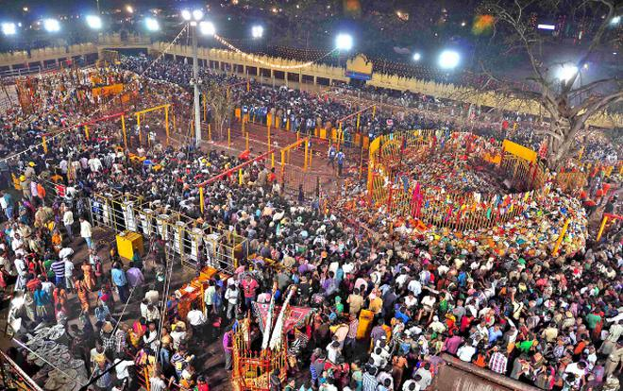
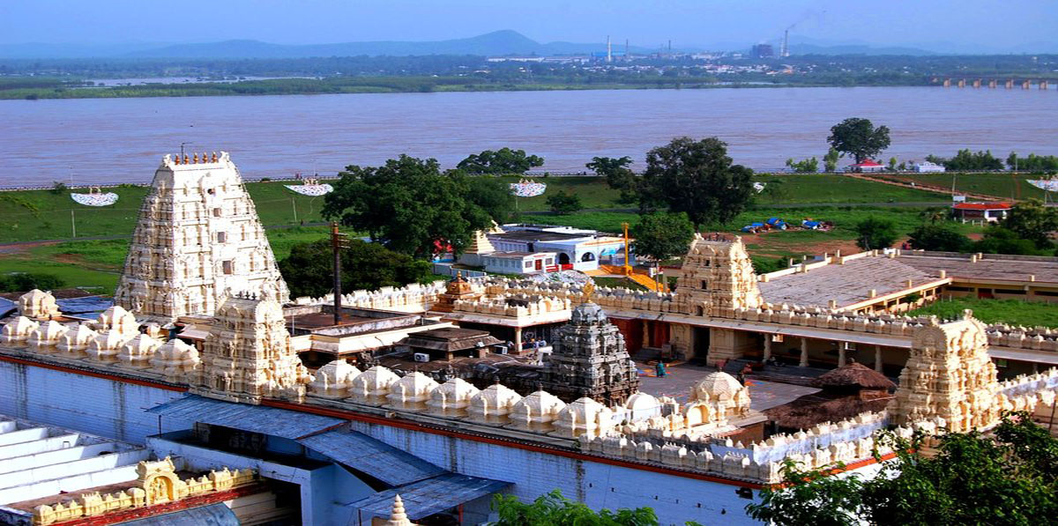
Jathara Festival Warangal
Bhadrachalam Temple
Bhadradri Kothagudem

Slide 9
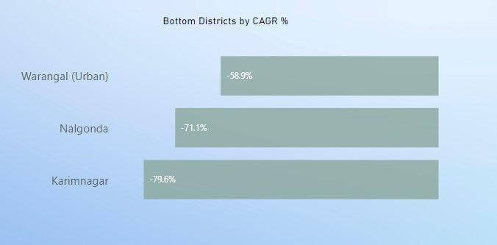
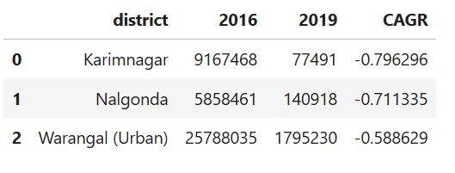
3. List down the bottom 3 districts based on CAGR of visitors between (2016-2019)?
The negative CAGR indicates in decline of tourist footfall over the years 2016-2019
Karimnagar, Nalgonda and Warangal (Urban) have the lowest Compound Annual Growth Rate (CAGR).

Slide 10

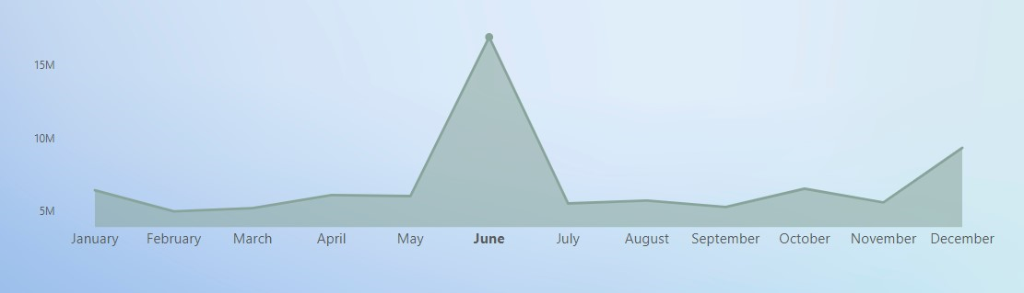
4. What are the peak and low season months for Hyderabad based on the data from 2016 to 2019 for Hyderabad district?
Domestic Visitors
In Hyderabad, domestic visitors peak in June, followed by December and October.
For June the maximum no. of visitors was contributed by 2016.
Hyderabad was ranked as “Second best place in the world one should see” in 2015 by National Geographic.
On Telangana Day (June 2, 2016) the state hoisted the largest India flag in the country. The day must have led to a large tourist influx.
December and January are the cooler months which provides an optimal tourism experience.

Slide 11
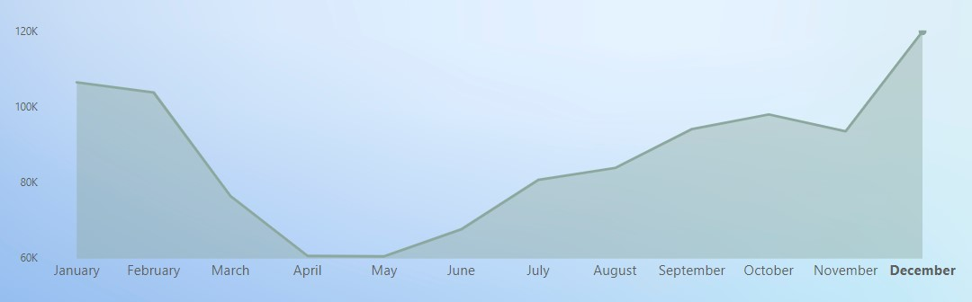
Foreign Visitors
In Hyderabad, Foreign visitors peak in December, followed by January and February.
The cooler months of December and January are much favourable for foreign tourists than the scorching summers which onset in April. Thus, the decrease in foreign tourist footfall.
Many cultural festivals throughout the year could also attract foreign tourists.
BONALU : July- August
DUSSEHRA & BATHUKAMMA : October
MEDARAM JATHARA : February (once in two years)

Slide 12
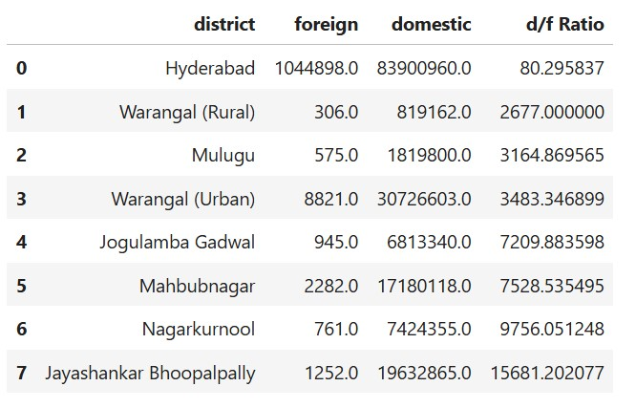
5. Show the top and bottom 3 districts with high domestic to foreign tourist ratio?
Hyderabad and Warangal (Rural) have low Domestic to Foreign Ratio which means these districts attract good number of Foreign tourists.
Nagarkurnool, Jayashankar Bhoopalpally have a massive gap bw the domestic and foreign tourists.
The Government needs to improve accessibility to other districts from Hyderabad and Warangal.
The foreign tourists need to be provided a State tourism package which enables them to explore the different districts.
Introduce luxury resorts in proximity to wildlife sanctuaries to inculcate the experience.

Slide 13
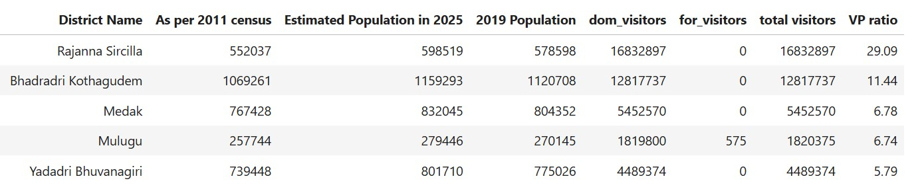
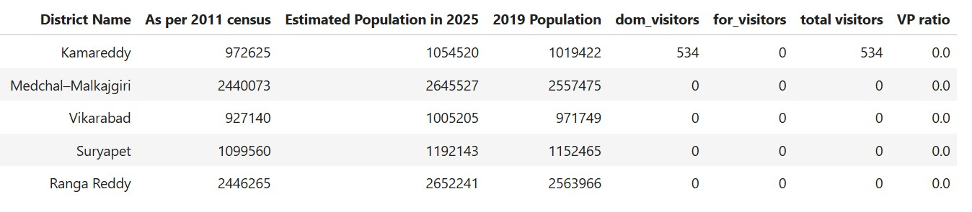
6. List the top & bottom 5 districts based on ‘population to tourist footfall ratio’ in 2019:
Rajanna Sircilla has the highest Visitors / Population ratio.
The following districts have 0 VP ratio which depicts the lack of tourist footfall.
These districts do have historic sites but need more promotion in terms of hospitality and accessibility.

Slide 14
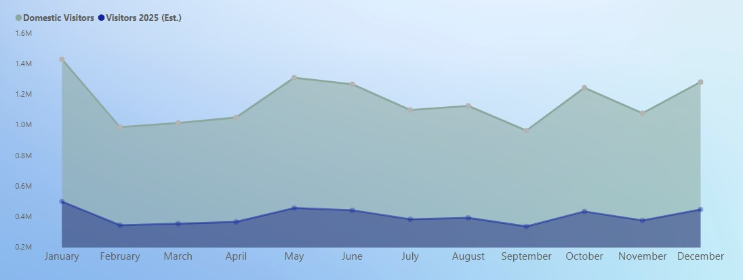
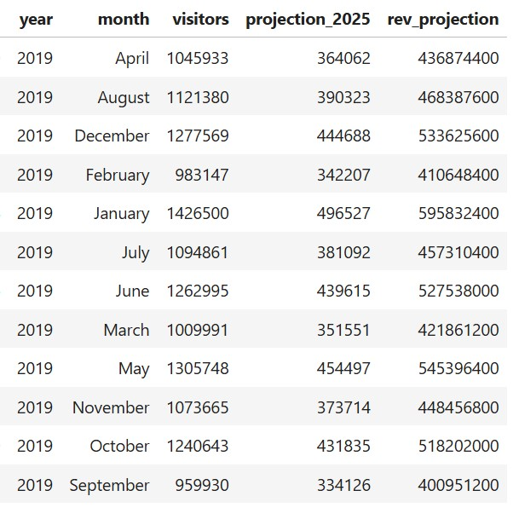
7. Projected number of domestic tourist and revenue generation in Hyderabad in 2025 based on the growth rate from previous years?
Visitors 2025 (Est.)
The CAGR % for Domestic tourist in Hyderabad for 2016-2019 is -16.1%. Thus, showing a decline in footfall for coming years.
The total domestic visitors are estimated to fall from 13.8M in 2019 to 4.8M in 2025.
Considering the average expenditure for a domestic tourist as ₹ 1,200, the total Revenue Est. for 2025 for Hyderabad would be ₹ 5.77bn.

Slide 15
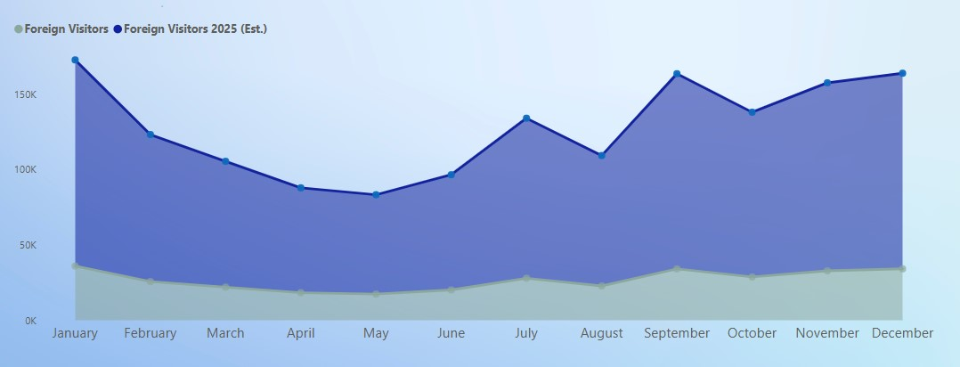
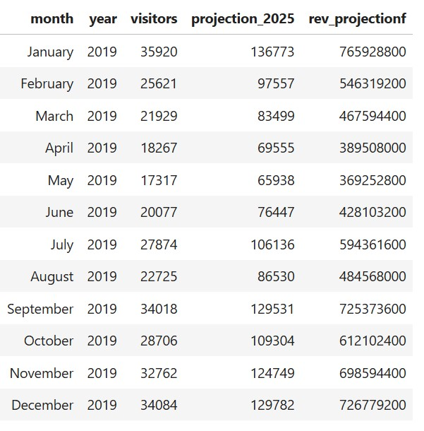
8. Projected number of foreign tourist and revenue generation in Hyderabad in 2025 based on the growth rate from previous years?
The CAGR % for Foreign tourist in Hyderabad for 2016-2019 is 25%. Thus, showing an increase in footfall for coming years.
The total Foreign visitors are estimated to increase from 319K in 2019 to 1.21M in 2025.
Considering the average expenditure for a Foreign tourist as ₹ 5,600, the total Revenue Est. for 2025 for Hyderabad would be ₹ 6.81bn.

Slide 16
POST-COVID ANALYSIS

Slide 17
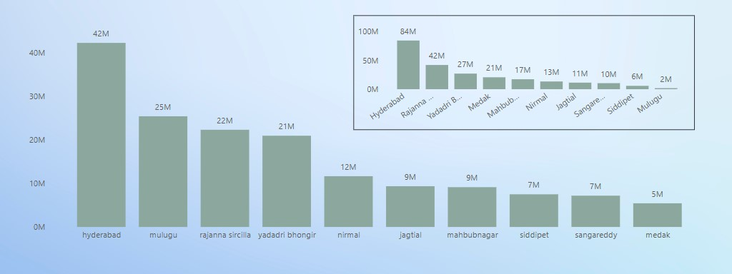
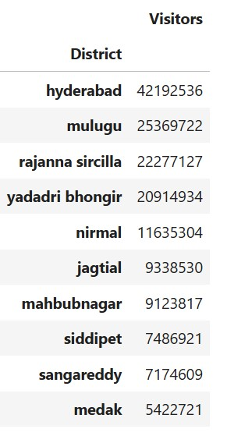
#Top 10 districts for Domestic Tourists
(2020-2023)
(2016-2019)
The no. of Domestic Tourists decreased greatly during the 2020-23 period due to the COVID-19 pandemic.
In Hyderabad, no. of Domestic tourists fell to 50% from 84M in 2016-2019 to 42M in 2020-2023.
The rise in Mulugu tourism is due to declaration of Ramappa Temple as UNESCO World Heritage site in 2021.

Slide 18
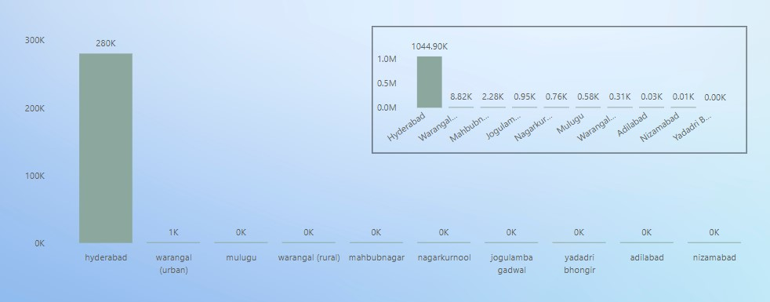
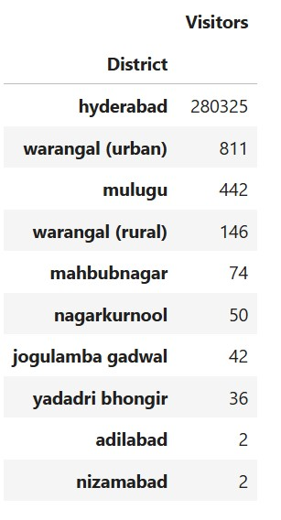
#Top 10 districts for Foreign Tourists
(2020-2023)
(2016-2019)
The no. of Foreign Tourists reduced drastically during the 2020-23 period due to the COVID-19 pandemic and strict regulations for traveling to different countries.
In Hyderabad, no. of Foreign tourists fell from 1.04M in 2016-2019 to 280K in 2020-2023.
Note : Warangal (urban) was renamed as Hanamkonda in 2021.

Slide 19
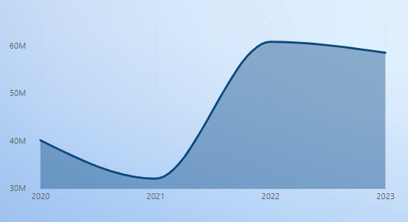
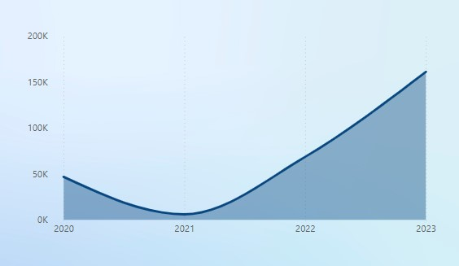
#Domestic and foreign yearly trend and reasons for the trend. Covid and then post covid policies
Domestic
Foreign
The onset of COVID in 2020 and the second wave in 2021 show a decline in tourists footfall in Telangana.
The tourist influx increases by 2022. However, it is yet to reach pre pandemic level.
The economic impact on population post pandemic, travel hesitancy, strict restrictions are the few factors for a slow recovery.

Slide 20
Initiatives to boost tourism in Post COVID era
New Tourism Policy 2025-2030: The key aspects include
Dedicated tourist police units
Implementing women friendly measures
Leveraging tourism friendly index (TFI) to evaluate safety standards.
Eco and Temple focused Tourism: significant emphasis on eco-tourism hubs in areas like Adilabad, Warangal, Nagarjuna Sagar and Vikarabad.
Safety and Infrastructure enhancements

Slide 21
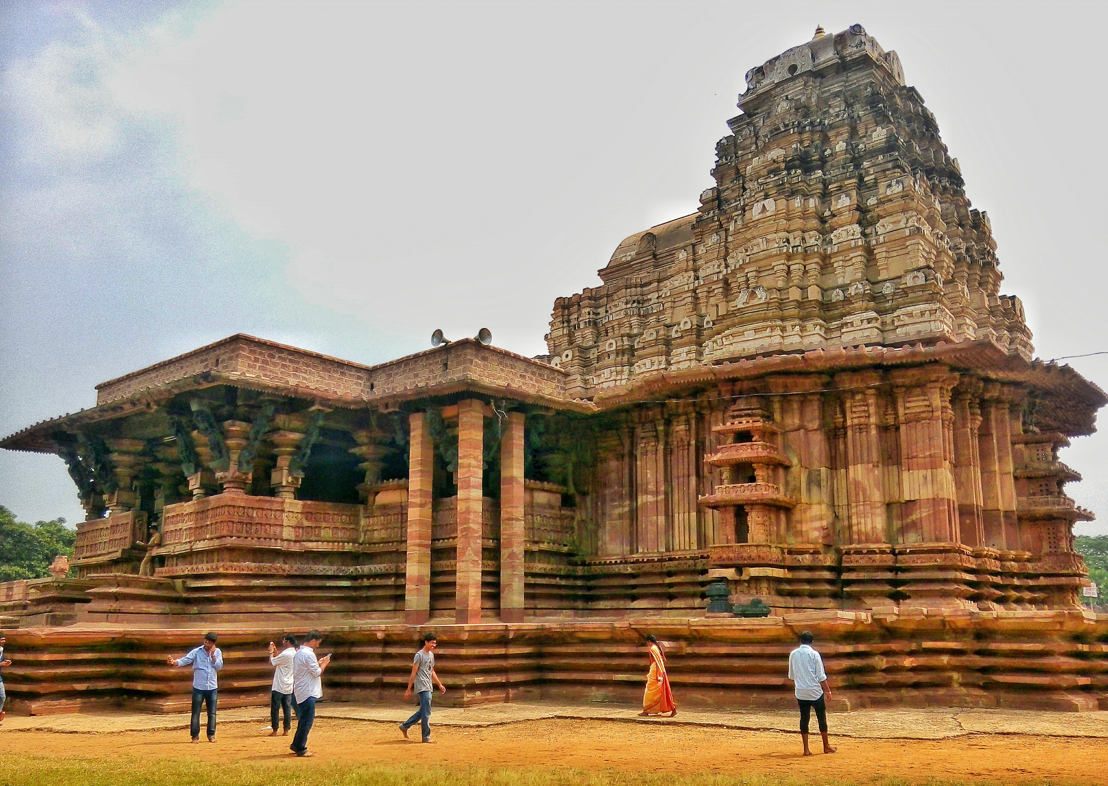
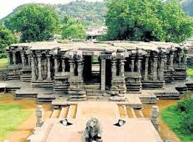
#Districts with highest potential for tourism growth
Warangal –Urban(Hanamkonda):
It is home to Warangal fort and Thousand pillar temple which are in the tentative list of UNESCO World Heritage Site.
Ramappa Temple situated in Mulugu is at proximity to visit.
The govt can lay emphasis on Heritage tourism in Hanamkonda. A famous celebrity should be appointed as the ambassador with whom people associate historic roles and culture of Telangana.

Slide 22
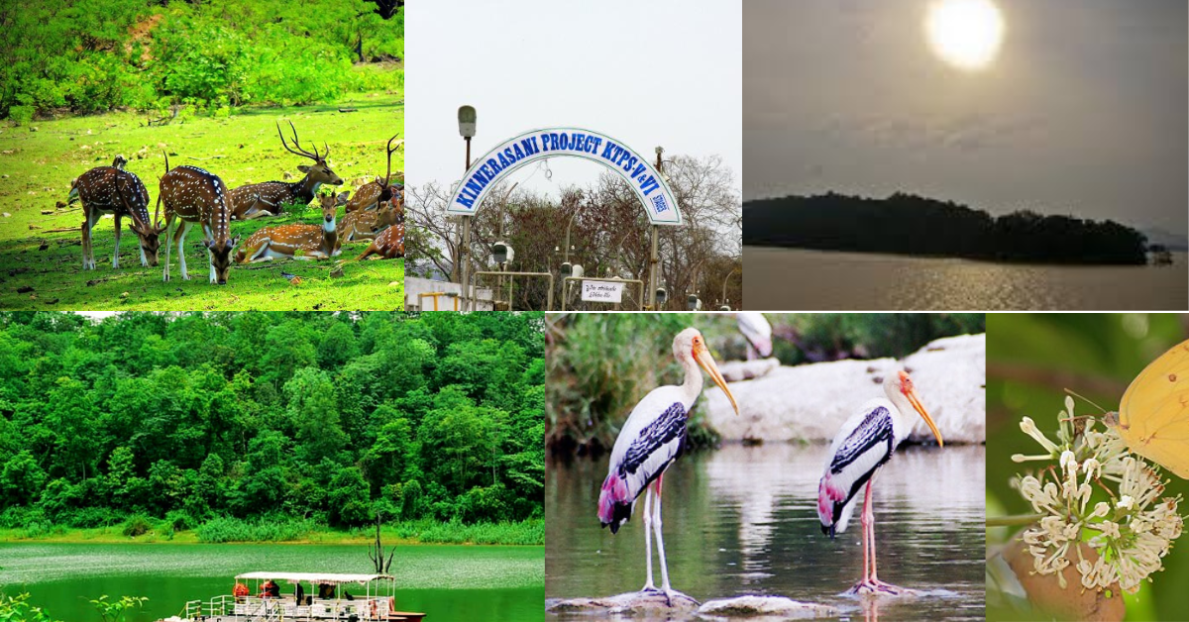
Bhadradri Kothagudem :
The rising tourism can be owed to development of the Kinnerasani Wildlife Sanctuary and the Bhadrachalam Temple.
This district needs better infrastructure in terms of improved roads, sanitation and development in hospitality sector.
The Hospitality sector can tap the market of Ethnic themed resorts which would attract longer tourists stay for the experience.

Slide 23
Cultural and Corporate Events to boost Tourism
EVENTS | WHERE? | WHEN?
BONALU Festival should be organized as a trademark of Telangana like Navratri is for Gujarat. Art and Folk exhibitions. Handloom Exhibitions Auto Expo, Trade shows, Tech Fest | Hyderabad & Secundarabad Adilabad & Nalgonda Warangal, Narayanpet & Gadwal Hyderabad | July or August Dec, Jan and February October November, December

Slide 24
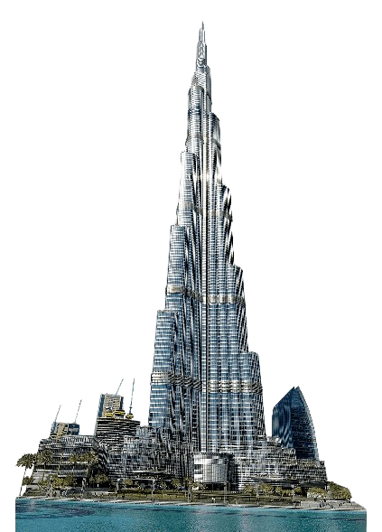

Business model of Dubai
What is distinctive about Dubai?
Infrastructure Dubai has world class infrastructure with Burj Khalifa, Palm Jumeirah, Smart city initiatives.
Business regulations Zero income tax, investor-friendly free zones, fast-tracked business setup process
Industry Thrives in oil economy and tourism
Tourism and Branding
Global tourism leader with luxury and adventure tourism as USP Global marketing campaigns

Slide 25
How is Hyderabad different?
Infrastructure Though Hyderabad has strong infrastructure, it needs investment to compete on a global scale.
Business regulations Lack of extra ordinary incentives as compared to Dubai.
Industry Strong in IT, Pharma and Aerospace
Tourism and Branding
Immense potential for Heritage tourism, medical tourism and film city prospects.

Slide 26
What does that mean for Hyderabad?
Dubai and Hyderabad are different in terms of geographical access, regulatory policies and branding.
While Hyderabad cannot exactly replicate the Dubai business model, it can focus on learning and innovating strategies as per its own system.
Heritage Tourism branding
Enhance public – private partnerships
Infrastructure development in tier 2 cities to expand growth beyond Hyderabad.

Slide 27
Recommendations
Create a strong tourism brand : Develop a unique identity.
Promote the art & culture of the state with Dance exhibitions, handloom exhibits, etc.
Run targeted campaigns in every season emphasizing on seasonal festivals and rituals.
Improve Infrastructure : Accessibility to key destinations.
Improve connectivity to districts with massive potential like Warangal, Bhadradri Kothagudem
Introduce luxury tours covering heritage circuits.
Develop a smart tourism app.
Develop ‘temple tourism’ circuit.

Slide 28
Digital Marketing:
Use social media platforms to spread awareness of the numerous festivals of Telangana like Bathukamma and Bonalu.
Promote a tagline for Telangana Tourism like “Experience Telangana – Timeless culture and Endless Adventure!”
Collaborate with travel vloggers to promote Telangana tourism.

Slide 29
Thank You

